Slide 1
Redis_RDB_Check COW & Latency
[Datos] 이봉원, 남상현

Slide 2
Contents
Memtier_Benchmark
User_Defined_Benchmark
Check Cow ( With ftrace )
Why?
1) Data Copy or Page Copy
2) Data Sending Latency
3) dbOverWrite( )

Slide 3
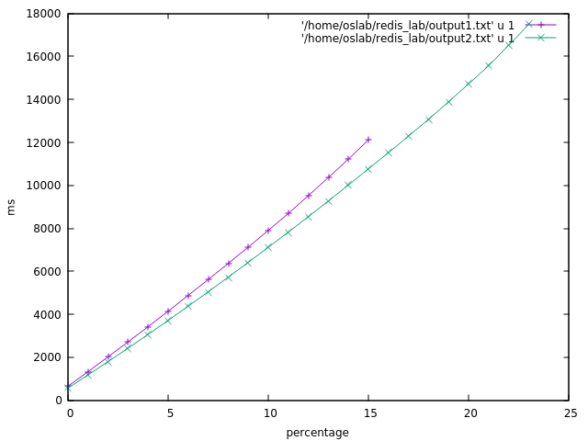
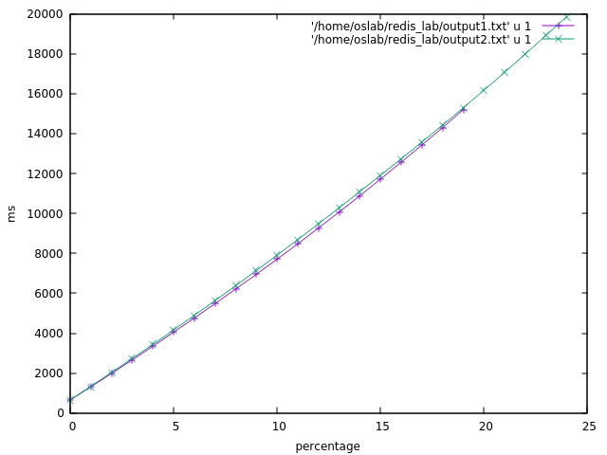
Memtier_Benchmark (1)
Configuration ( T 1 / C 1 / D 400MB / N 100)
NO_RDB
WITH_RDB

Slide 4
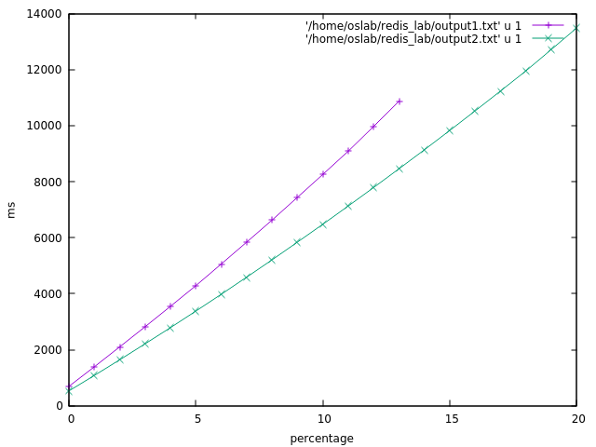
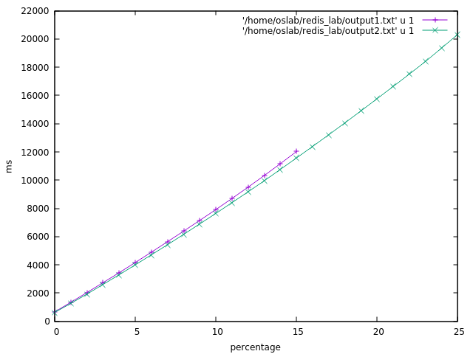
Memtier_Benchmark (2)
Configuration ( T 1 / C 1 / D 400MB / N 100)
NO_RDB
WITH_RDB

Slide 5
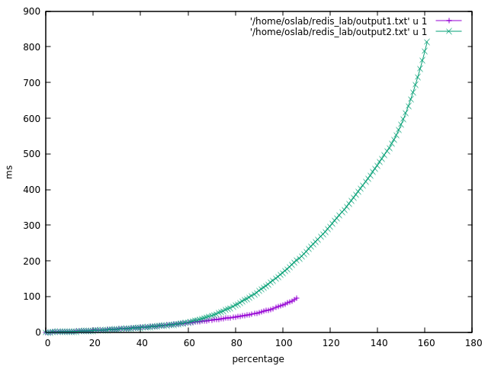
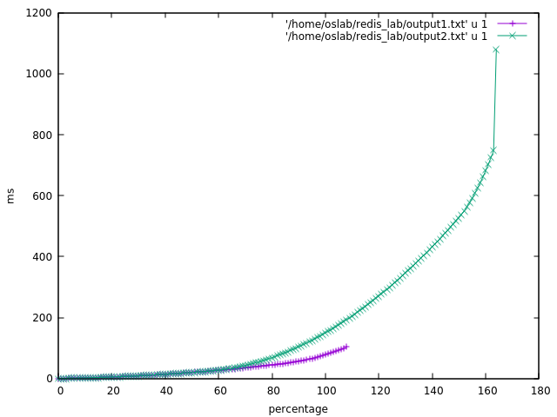
Memtier_Benchmark (1)
Configuration ( T 1 / C 1 / D 100KB / N 210000)
NO_RDB
WITH_RDB

Slide 6
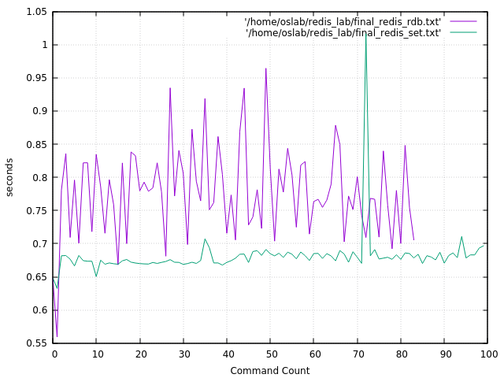
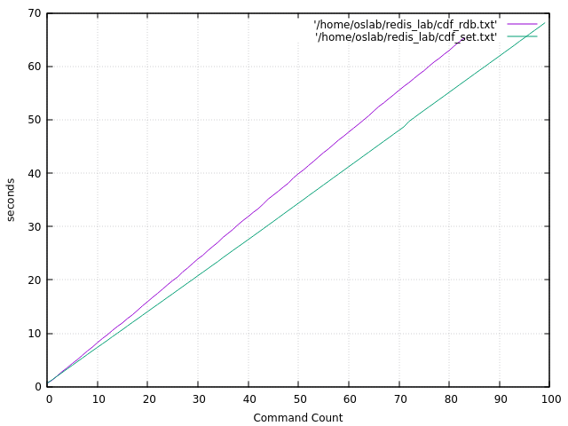
User_Defined_Benchmark (1)
Configuration ( T 1 / C 1 / D 400MB / N 100)

Slide 7
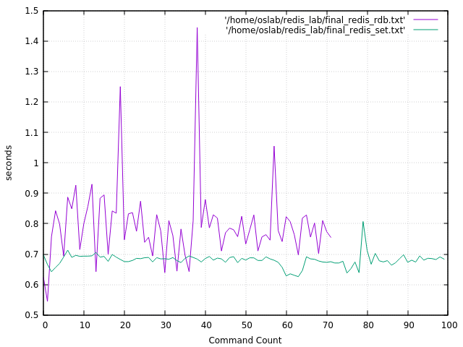
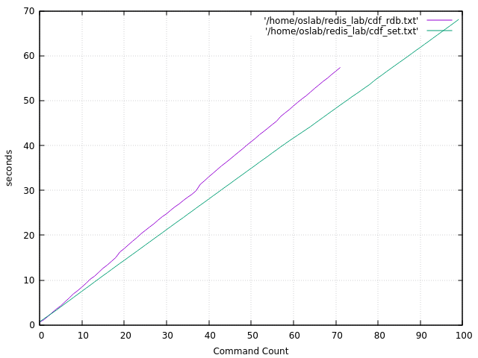
User_Defined_Benchmark (2)
Configuration ( T 1 / C 1 / D 400MB / N 100)

Slide 8
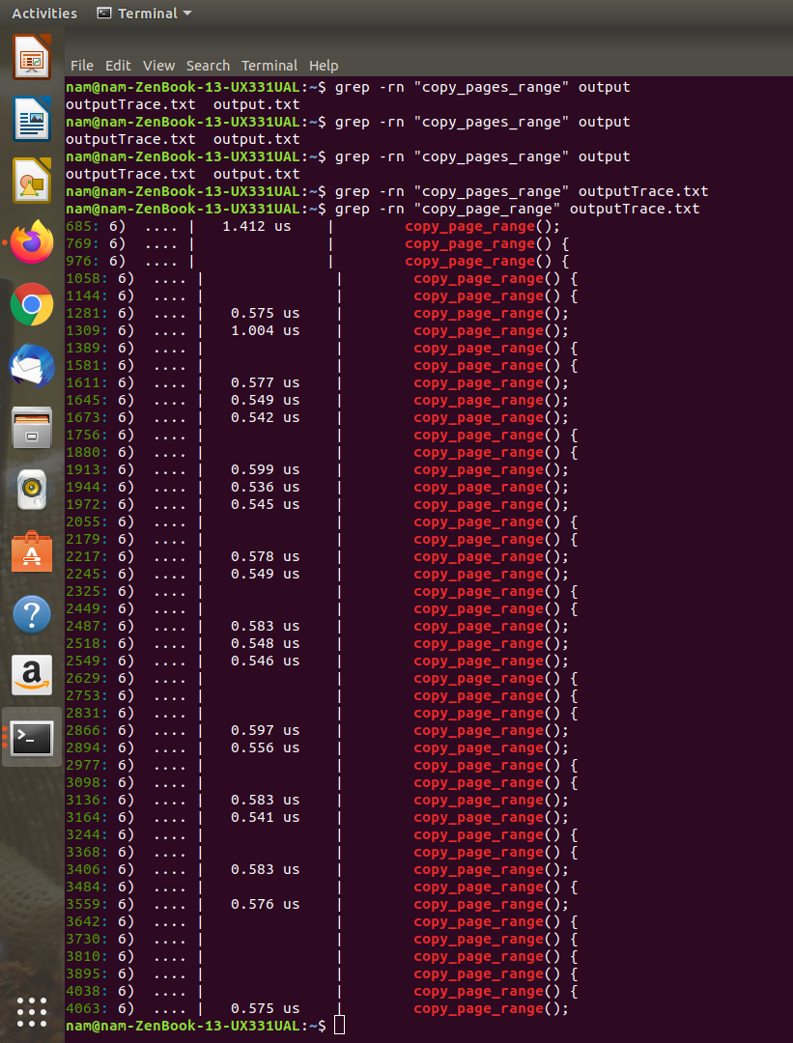
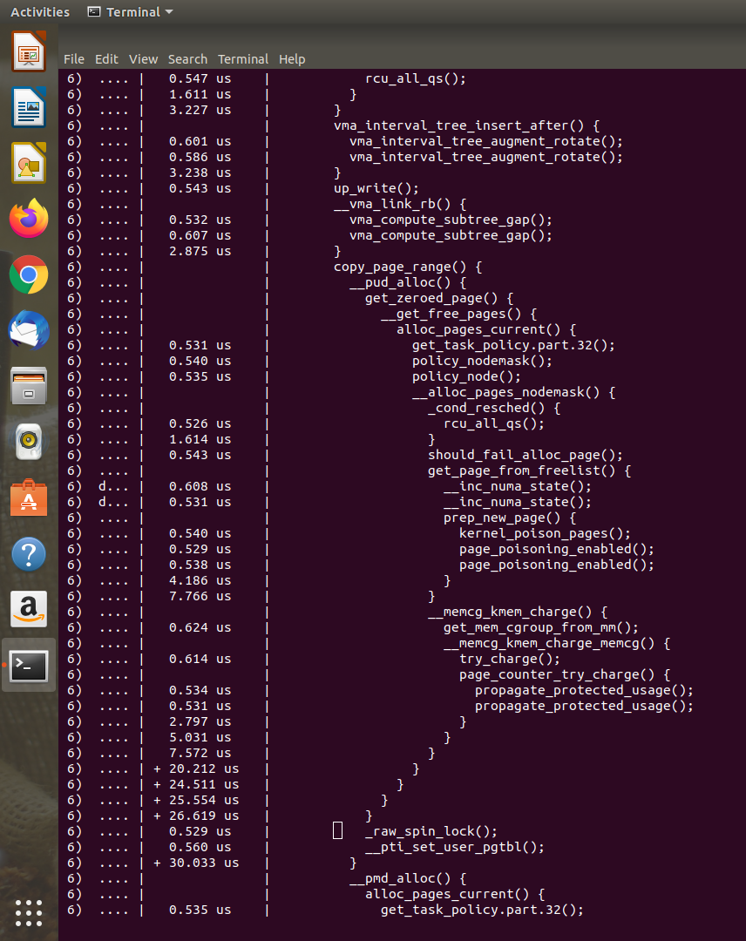
Check COW ( With ftrace )

Slide 9
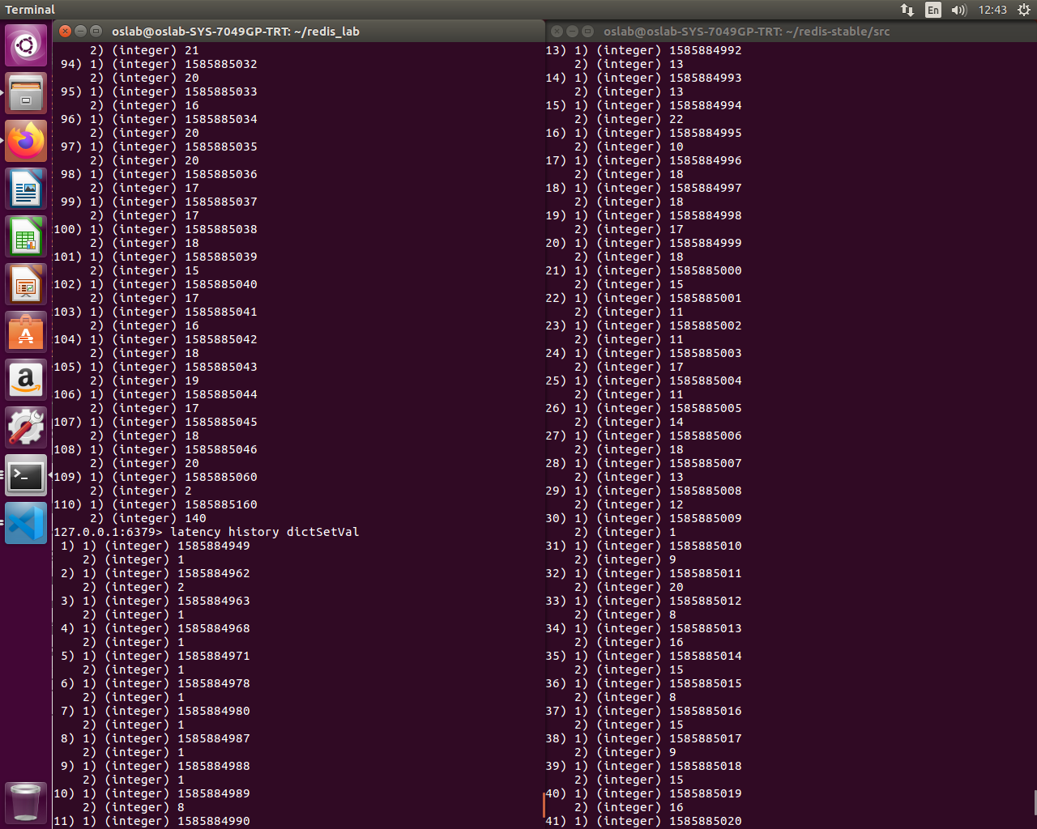
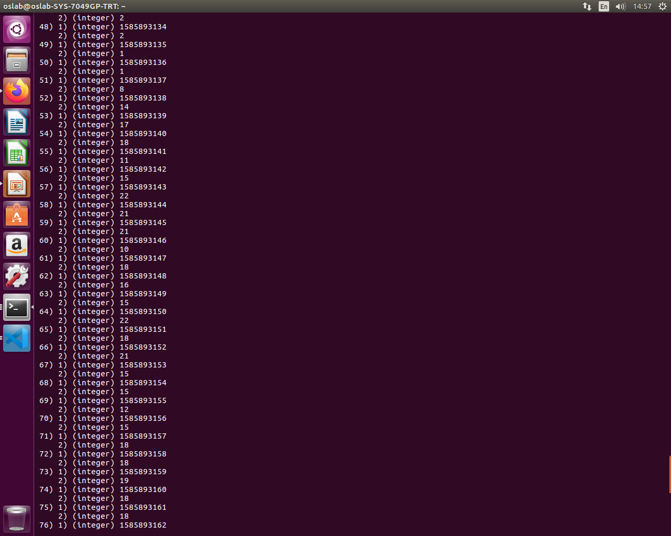
Redis Internal latency
DictSetVal
ProcessCommand

Slide 10
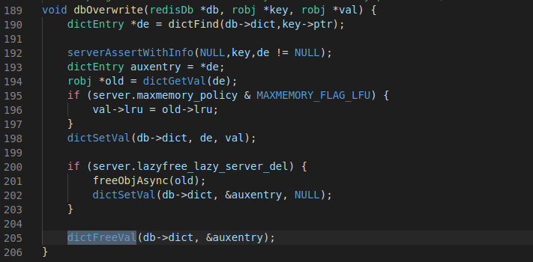
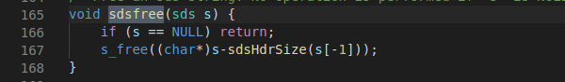
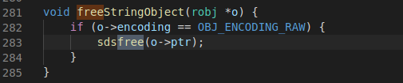
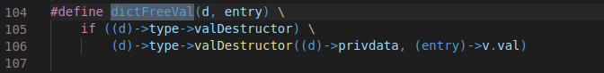
dbOverWrite( )

Slide 11
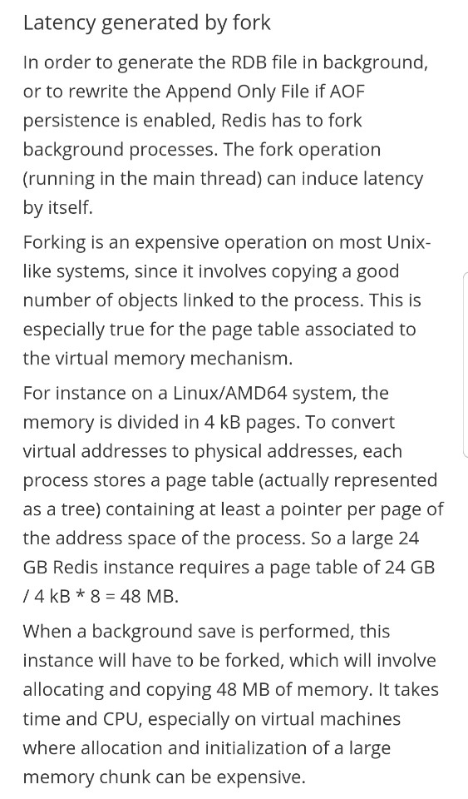

Slide 12
THANK YOU

